Slide 1

GE100 - Application of Information and Communication Technologies
Lec # 1: Introduction to the World of Computers
Instructor: Alina Maryum

Slide 2
About the Course
Pre-requisite Course: None
Students should be able to:
Understand the foundations, concepts, fundamentals, theories, and principles of information and communication technologies
Explore and navigate through the history of computing
Give insights of emerging technologies
Develop skills for understanding and creating interactive and dynamic websites
Understand the importance of digital information security and cybersecurity basics
Learn to handle and analyze data using popular software tools

Slide 3
About the Course
Textbook:
Charles S. Parker, Understanding Computers: Today and Tomorrow, Course Technology, 25 Thomson Place, Boston, Massachusetts 02210, USA
Reference Material
Livesley, Robert Kenneth. An introduction to automatic digital computers. Cambridge University Press, 2017.
Computer Fundamentals Book Edition 8 by Pradeep Sinha, Priti Sinha
Zawacki-Richter, Olaf, and Colin Latchem. "Exploring four decades of research in Computers & Education." Computers & Education 122 (2018): 136-152.

Slide 4
Grading Criteria
Type of Assessment | Percentage
Assignments | 5
Quizzes | 10
PBLs | 5
Mid Term Exam | 30
Final Term Exam | 50

Slide 5

Google Classroom Code

Slide 6
Lecture # 1 Introduction to the World of Computers

Slide 7
Learning Objectives
Explain why it is essential to learn about technology today and discuss several ways computing devices are integrated into our business and personal lives
Define a computer and describe its primary operations
List some important milestones in computer evolution
Identify the major parts of a personal computer, including input, processing, output, storage, and communications hardware
Discuss the societal impact of computers and technology, including some benefits and risks related to their prominence in our society

Slide 8
Technology in Your Life
Why Learn about Computers and technology?
Pervasive computing
Also known as ubiquitous computing
Computers and technology have become an integral part of our lives
Basic computer literacy
Understanding what a computer is and how it works
Notes:
Pervasive Computing (also known as Ubiquitous Computing) refers to the integration of computing processes into everyday objects and activities. In this paradigm, technology becomes seamlesssly embedded in our environments, making computing available everywhere, in the background, without the user necessarily being aware of it.
Smart Homes:
Wearable Devices:
Smart Cities:
Healthcare:

Slide 9
Technology in Your Life
Before 1980
Computers were large and expensive
Very few people had access to them
Computers were mostly used for high-volume processing tasks
Microcomputers in the early 1980s
Inexpensive personal computers
Computer use increased dramatically

Slide 10
Technology in Your Life
Today
Nearly 90% of US households include a computer, and most use computers at work
Electronic devices are converging into single units with multiple capabilities
Check e-mail on living room television
View Internet content on mobile devices
Computer literacy is an essential skill for everyone

Slide 11
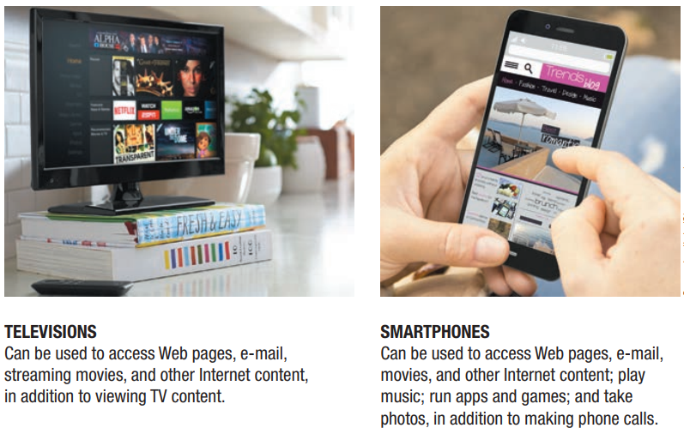
Technology in Your Life

Slide 12
Computing devices in the Home
Computers are used for a variety of tasks:
Looking up information and news
Exchanging e-mail
Research products
Shopping and paying bills
Watching TV and videos
Downloading music and movies
Organizing digital photographs
Playing games
Check news and weather
Making vacation plans

Slide 13
Computing devices in the Home
Used for reference, productivity, and entertainment
Wireless Networking
Computers can be used in nearly any location
Smart Appliances
Traditional appliances with built-in computer or communication technology
Smart Homes
Household tasks are monitored and controlled by a main computer in the house

Slide 14
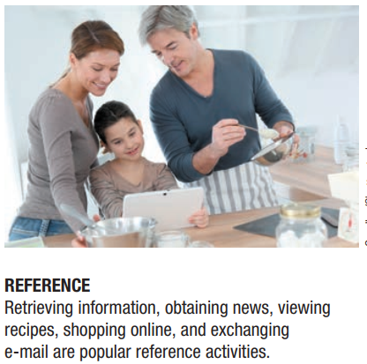
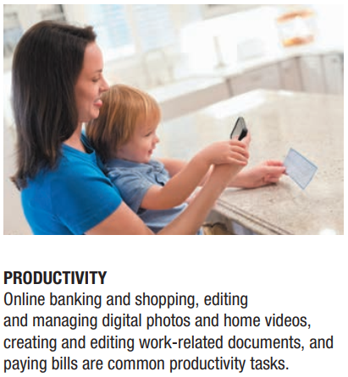
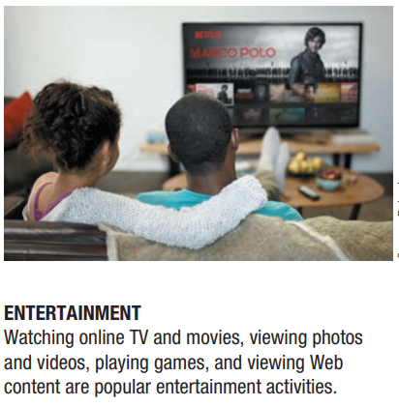
Computing devices in Home

Slide 15
Computing devices in Education
Youth today: the computing generation
Computer labs and classrooms
Most students today have access to computers at school
Some schools integrate e-books into the curriculum
Wireless hotspots
Colleges and universities are even more integrated
Some have computer requirements for enrollment
Supplied or Bring Your Own Device (BYOD)
Distance learning
Students participate from locations other than the traditional classroom setting using computers and Internet access
Notes:
Bring Your Own Device (BYOD) is a policy or practice in which employees are allowed or encouraged to use their personal devices (such as smartphones, tablets, or laptops) to access company systems, applications, and data for work purposes. This approach has become popular as technology has advanced and mobile devices have become more capable of handling work-related tasks.

Slide 16
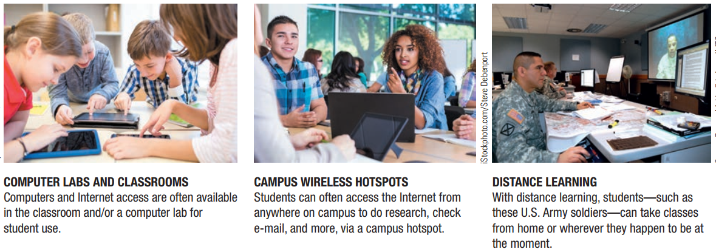
Computing devices in Education

Slide 17
Computing devices on the Job
Computers have become a universal on-the-job tool for decision-making, productivity, and communication
By all types of employees
For access control and other security measures
For service professional use
Extensively by the military
Requires continually refreshing computer skills
Common uses
Decision making, productivity, off-site communications, and authentication

Slide 18
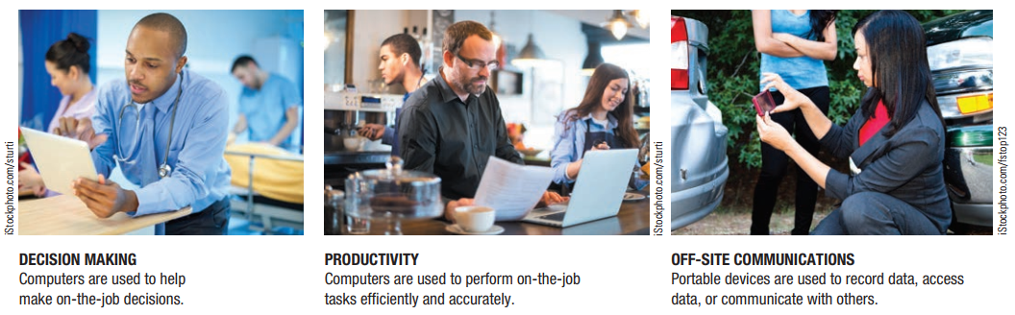
Computing devices on the Job

Slide 19
Computing devices on the go
Computers are encountered in nearly every aspect of daily life
Consumer kiosks
ATM transactions
POS systems at retail stores
Self-checkout systems
Consumer authentication systems
Portable computers or mobile devices
GPS systems
Notes:
Consumer kiosks are self-service terminals designed to assist customers with various tasks, providing convenience and efficiency in public spaces, retail environments, or service locations. These kiosks typically feature touchscreens or interactive interfaces, allowing users to perform activities such as shopping, information lookup, ticketing, or payments without direct assistance from staff.

Slide 20
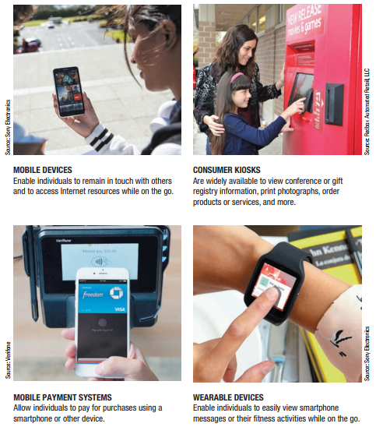
Computing devices on the go

Slide 21
What is a Computer and What does it do?
Computer
A programmable, electronic device that accepts data, performs operations on that data, and stores the data
Follows instructions, called programs, which determine the tasks the computer will perform
Basic Operations
Input: Entering data into the computer
Processing: Performing operations on the data
Output: Presenting the results
Storage: Saving data, programs, or output for future use
Communications: Sending or receiving data

Slide 22
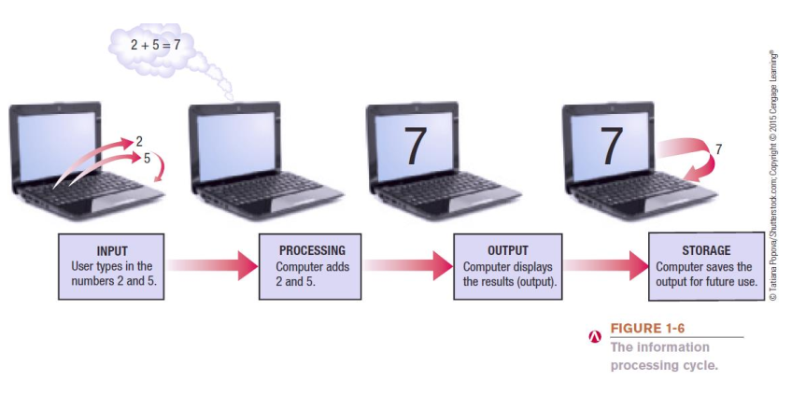
What is a Computer and What does it do?

Slide 23
Data vs. Information
Data
Raw, unorganized facts
Can be in the form of text, graphics, audio, or video
Information
Data that has been processed into a meaningful form
Information Processing
Converting data into information
Notes:
Data: Numbers, dates, or words like "120", "ABC", "01/01/2024" are data.
Information: John scored 120 points in the test on 01/01/2024" is information derived from raw data.

Slide 24
Computers Then and Now
The basic ideas of computing and calculating are very old, going back thousands of years
The computer as we know it is a fairly recent invention
The history of computers is often referred to in terms of generations
Each new generation is characterized by a major technological development

Slide 25
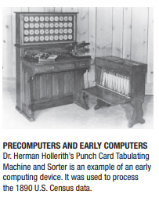
Computers Then and Now
Precomputers and early computers (before approx. 1946)
Abacus, slide rule, mechanical calculator
Punch Card Tabulating Machine and Sorter

Slide 26
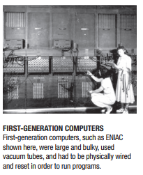
Computers Then and Now
First-generation computers (1946-1957)
Enormous and powered by vacuum tubes
Used a great deal of electricity and generated a lot of heat
Could solve only one problem at a time
Needed to be physically rewired with cables in order to be reprogrammed
Paper punch cards and paper tape for input and output was printed on paper
ENIAC and UNIVAC

Slide 27
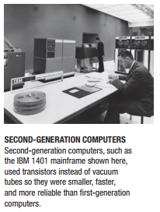
Computers Then and Now
Second-generation computers (1958-1963)
Used transistors - small device made of semiconductor material that acts like switch to open or close electronic circuits
Computers were smaller, more powerful, cheaper, more energy-efficient, and more reliable
Punch cards and magnetic tape were used to input and store data
Hard drives and programming languages as FORTRAN and COBOL were developed and implemented

Slide 28
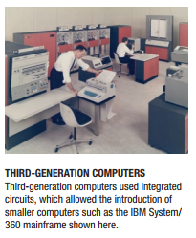
Computers Then and Now
Third-generation computers (1964–1970)
Replacement of the transistor with integrated circuits (ICs)
Integrated circuits incorporate many transistors and electronic circuits on a single tiny silicon chip
Keyboards and monitors used for input and output; hard drives were used for storage
IBM System/360, UNIVAC 1108

Slide 29
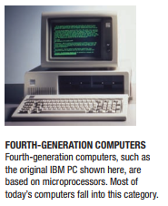
Computers Then and Now
Fourth-generation computers (1971–present)
Invention of the microprocessor
Microprocessor contains the core processing capabilities of an entire computer on one single chip
Keyboard and mouse for input, a monitor and printer for output, and hard drives, flash memory media, and optical discs for storage
Development of computer networks, wireless technologies, and the Internet
IBM PC and Apple Macintosh

Slide 30
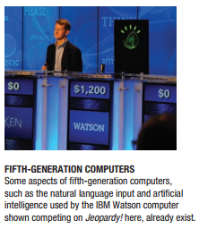
Computers Then and Now
Fifth-generation (now and the future)
Infancy stage
May be based on artificial intelligence (AI)
Will likely use voice and touch input
May be based on optical computers and utilize nanotechnology
Notes:
A cognitive computing system capable of understanding natural language, analyzing large amounts of data, and providing answers, famously used in the healthcare and business sectors.

Slide 31
Hardware
The physical parts of a computer
Internal hardware
Located inside the main box (system unit) of the computer
External hardware
Located outside the system unit
Connect to the computer via a wired or wireless connection
Hardware devices are associated with all five computer operations

Slide 32
Hardware
Input Devices
Used to input data into the computer
Keyboards, mouse, scanners, cameras, microphones, touch pads, touch screens, fingerprint readers, etc.
Processing Devices
Perform calculations and control computer’s operation
Central processing unit (CPU) and memory
Output Devices
Present results to the user
Monitors, printers, speakers, projectors, etc.

Slide 33
Hardware
Storage Devices
Used to store data on or access data from storage media
Hard drives, CD/DVD discs and drives, USB flash drives, etc.
Communications Devices
Allow users to communicate with others and to electronically access remote information
Modems, network adapters, routers, etc.

Slide 34
Software
The programs or instructions used to tell the computer hardware what to do
System Software
Operating system starts up the computer and controls its operation
Without OS, computer cannot function
Boots the computer and launches programs at the user’s direction
Most use a GUI to interact with the user via icons, buttons, tiles, etc.
Windows, Mac OS, Linux, Android, etc.

Slide 35
Software
Application Software
Performs specific tasks or applications
Creating letters, budgets, etc.
Managing inventory and customer databases
Editing photographs
Scheduling appointments
Viewing Web pages
Exchanging e-mail
Burning DVDs
Designing homes
Playing games

Slide 36
Computer Users and Professionals
Computer Users (end users)
People who use a computer to obtain information
Computer professionals
Programmers
Write programs computers use
Systems analysts
Design computer systems
Computer operations personnel
Manage day-to-day computer operations
Security specialists
Secure computers and networks against hackers

Slide 37
Technology and Society
The vast improvements in technology over the past decade have had a distinct impact on daily life, at home and at work
Many benefits of a technology-oriented society
Ability to design products before construction leads to safer products
Earlier medical diagnoses and more effective treatment
Devices that allow physically and/or visually challenged individuals to perform job tasks
Documents e-mailed or faxed in moments
Download information, music, programs, movies, and more on demand

Slide 38
Technology and Society
Technology-oriented society also has risks
Stress and health concerns
Spam
Computer viruses and malware
Identity theft and phishing
Security issues
Privacy issues
How data is collected
How secure is the collected data

Slide 39
Technology and Society
Differences in online communications
Less formal than traditional
Netiquette
Be polite and considerate of others
Refrain from offensive remarks
Abbreviations (acronyms) and emoticons
Acronyms, such as BTW (by the way)
Illustrations of faces, such as ☺
Notes:
Netiquette, short for "network etiquette," refers to the set of rules and guidelines for proper and respectful behavior in online communication.

Slide 40
Technology and Society
The Anonymity Factor
Online communications lend themselves to anonymity
Gives many individuals a sense of freedom
Can also be abused
Information Integrity
Use common sense when evaluating online content
Check your source--not all information on the Internet is accurate
Notes:
Misuse of technology for harmful purposes. Examples include:
Cyberbullying: Using digital platforms to harass or intimidate others.
Online Scams: Fraudulent schemes aimed at deceiving people into giving away personal information or money.
Data Misuse: Unauthorized access, theft, or exploitation of personal data.

Slide 41
Summary
Technology in your life
What is Computer and what does it do?
Data and Information
Evolution of Computers
Hardware and Software
Computer Users and Professionals
Technology and Society

